Slide 1
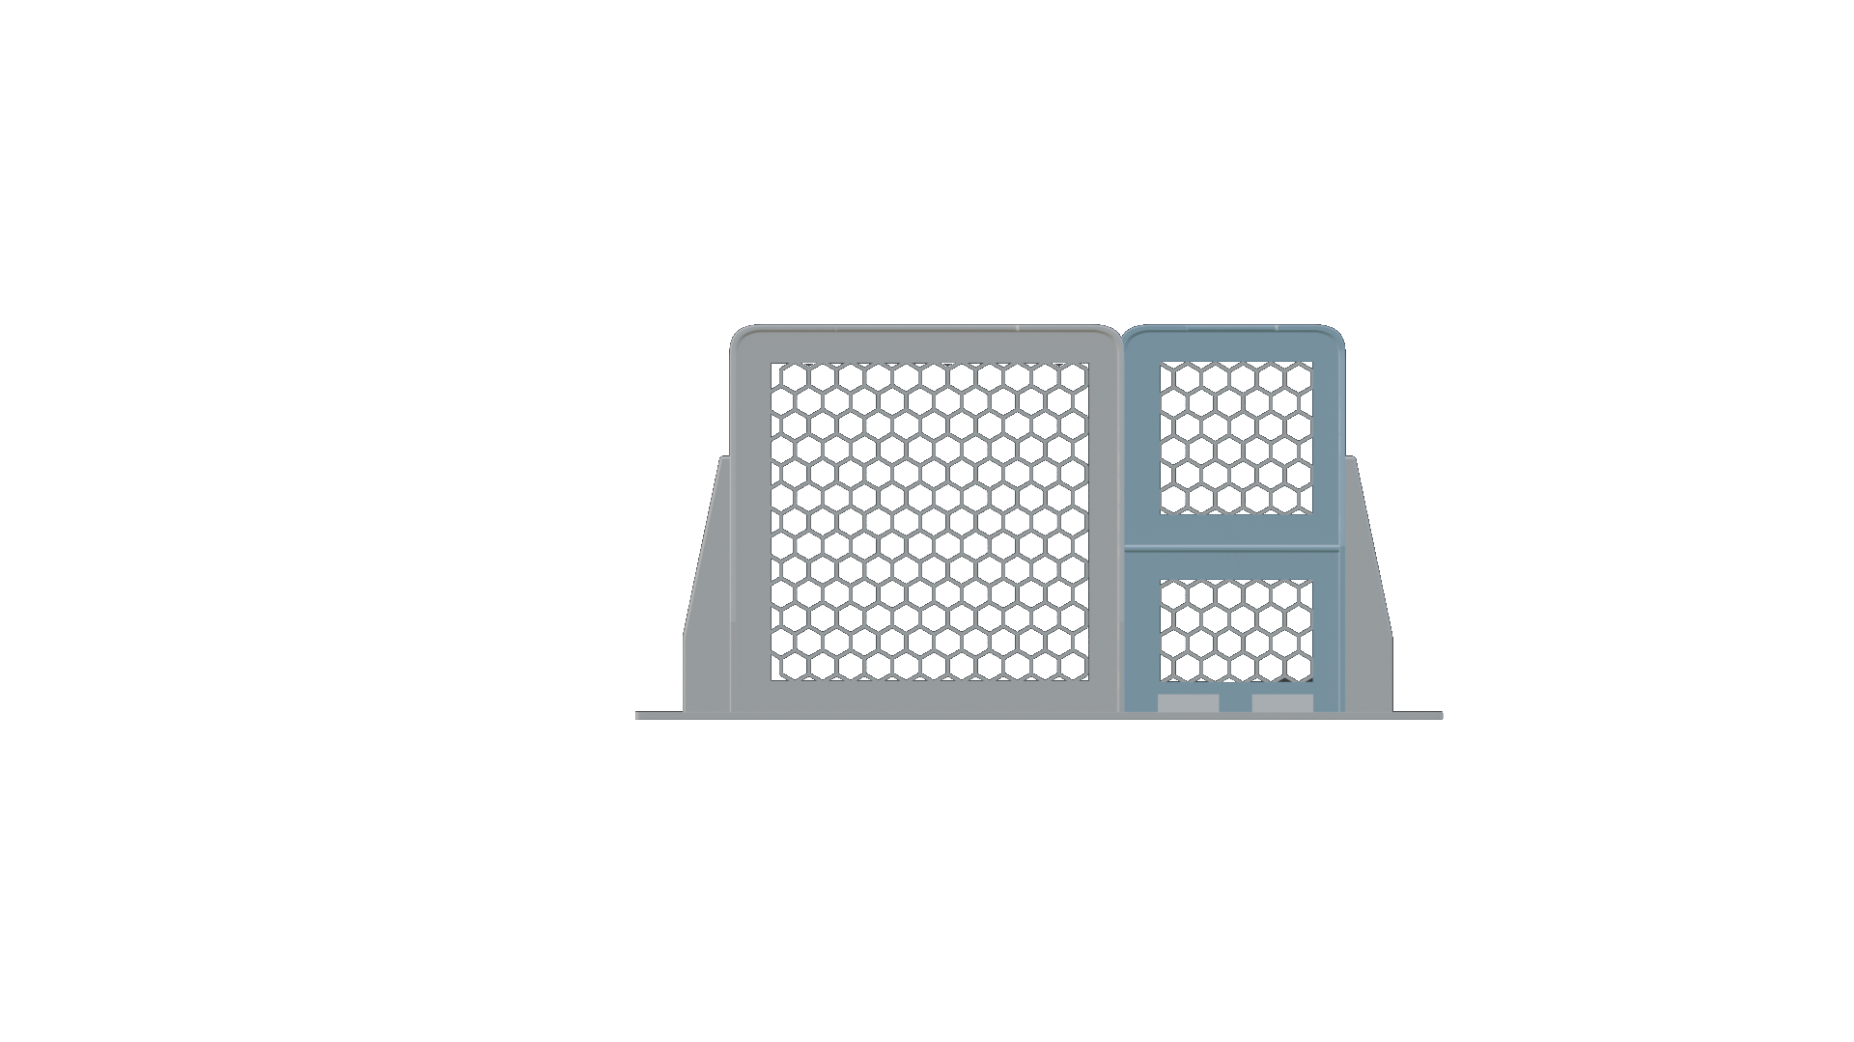
10” Rackmount for Unifi Express 7 (UX7)
Modular print sections
1: Front Panel including keystone jacks
2: Main UX7 Module
3: Network and Power management Module
Dimensions (W x D x H) : 253 x 126 x 44 mm
2
3
1

Slide 2
10” Rackmount for Unifi Express 7 (UX7)
Top view
1: LED Display
2: 2x Keystone Jacks
3: Main Unit
4: Power supply
5: Cables management
Dimensions (W x D x H) : 253 x 126 x 44 mm
4
3
5
1
2

Slide 3
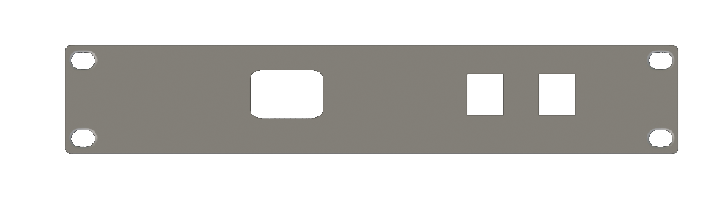
10” Rackmount for Unifi Express 7 (UX7)
Front view
1: LED Display
2: 2x Keystone Jacks
Dimensions (W x D x H) : 253 x 126 x 44 mm
1
2

Slide 4
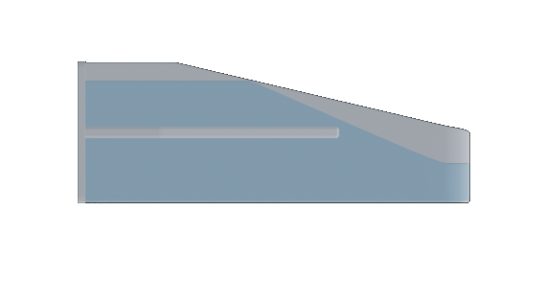
10” Rackmount for Unifi Express 7 (UX7)
7
Side view
6: Additional strength
7: UX7 will overhand ~3mm
Dimensions (W x D x H) : 253 x 126 x 44 mm
6

Slide 5



Slide 6

%H1 TITLE%
%H2 sub-title%
%body%

